Slide 1
Lecture 10 ➔ Human-machine interaction
András Lőrincz
Department of Artificial Intelligence
Faculty of Informatics

Slide 2
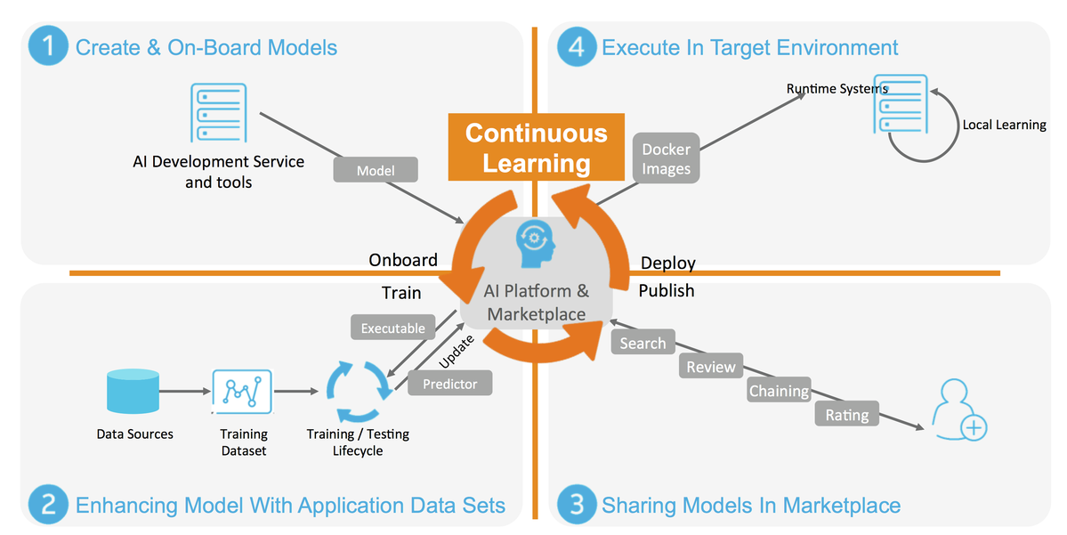
Interaction of the 1st kind: Acumos Making Artificial Intelligence Accessible To Everyone

Slide 3
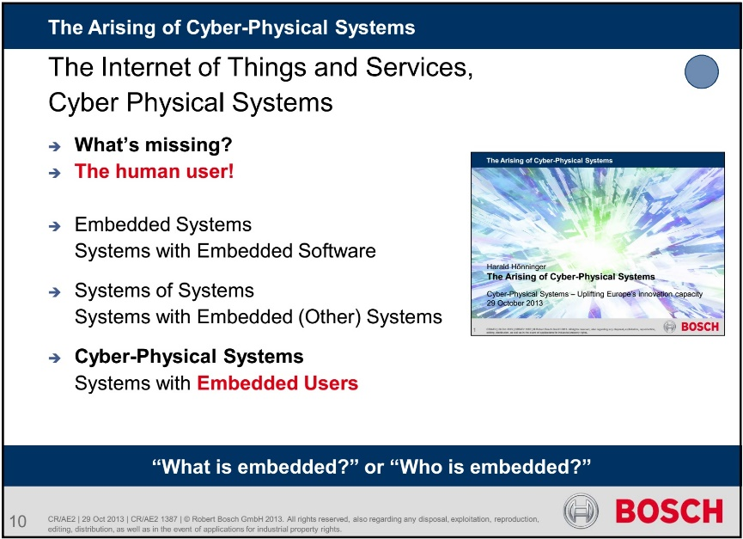
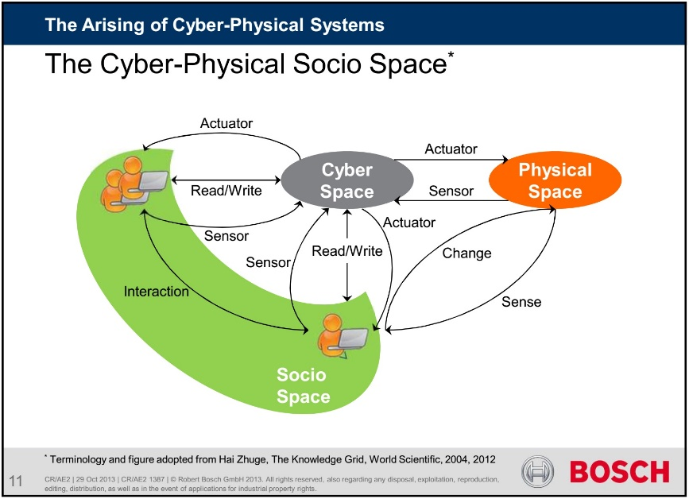
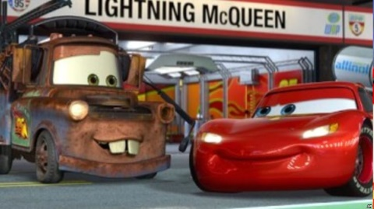
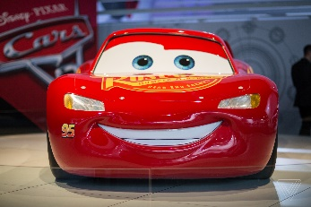
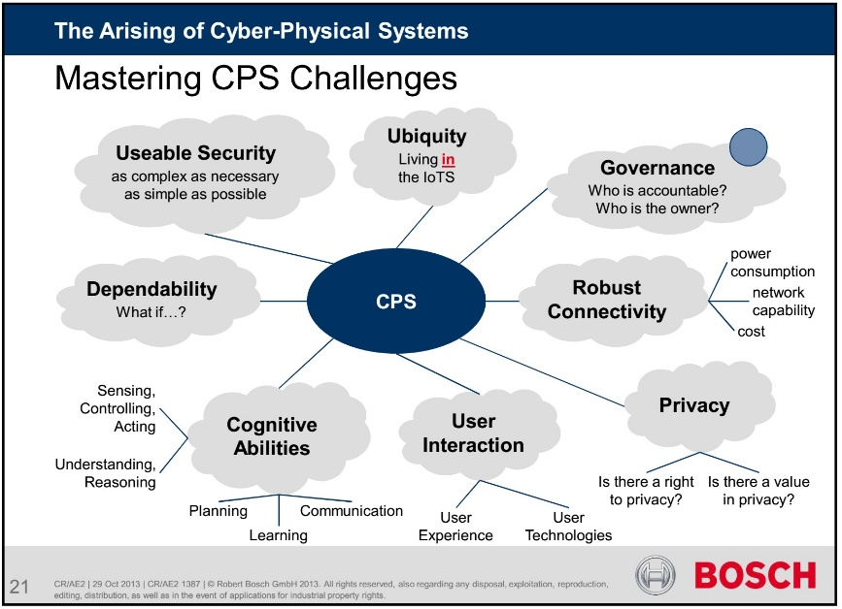
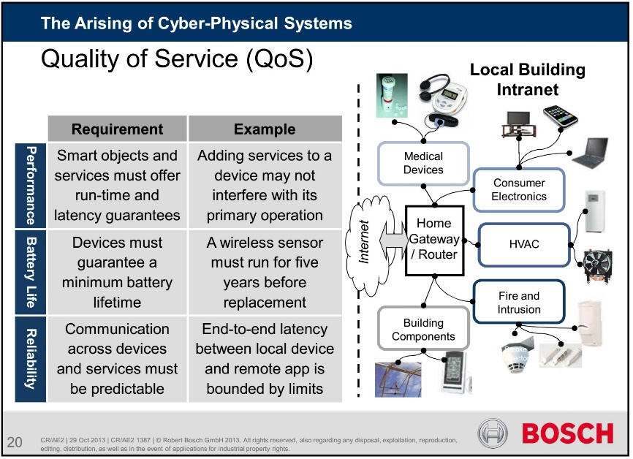
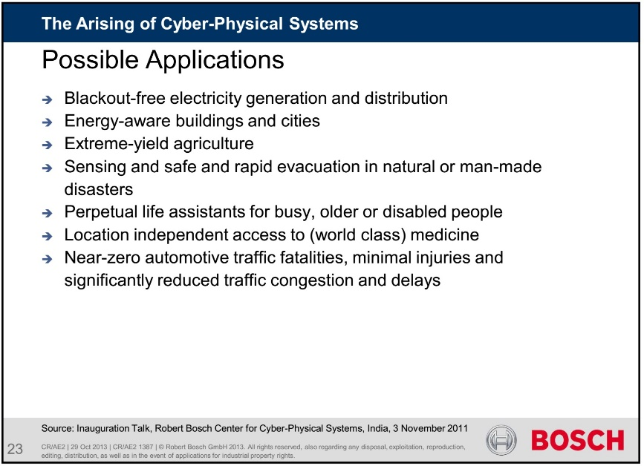
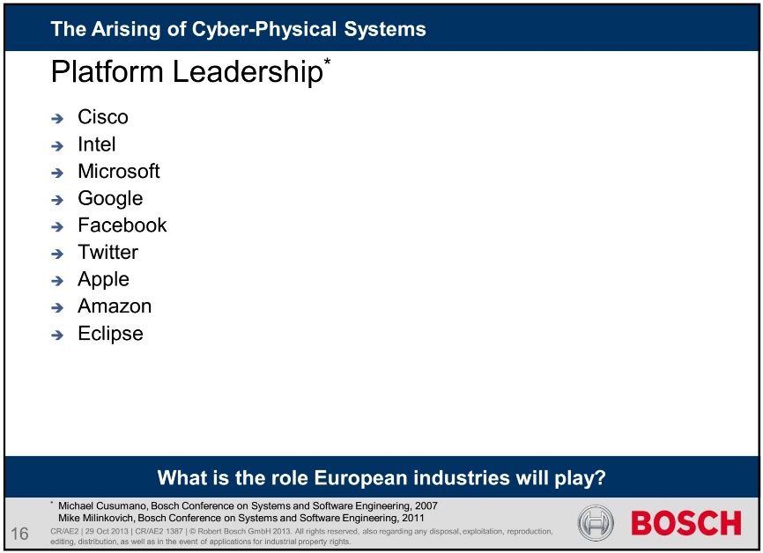
What is missing?
Missing
elements
from the vision
in 2013
are added
and
highlighted
Harald Hönninger
29 October 2013
Environment
Socio Space
Worst case execution time
risk considerations
verification
Missing
elements
from
Bosch’s vision
in 2013
are added
and highlighted
Alibaba
Baidu
Didi Chuxing
Sogou
Toutiao
Uber
Xiaomi
WeChat
All of these should be combined
in a single platform
Autonomous Driving

Slide 4
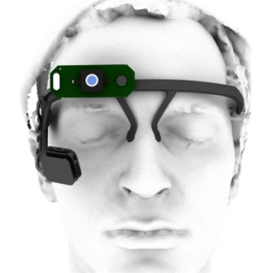
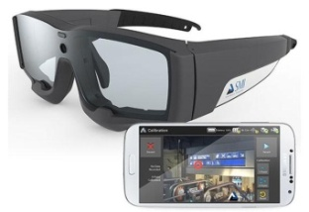
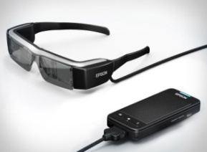
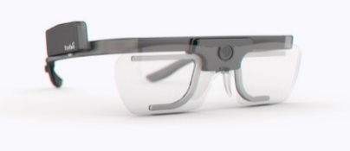
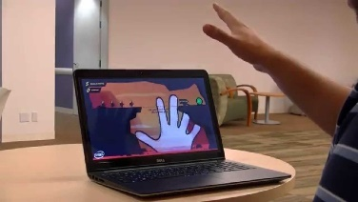
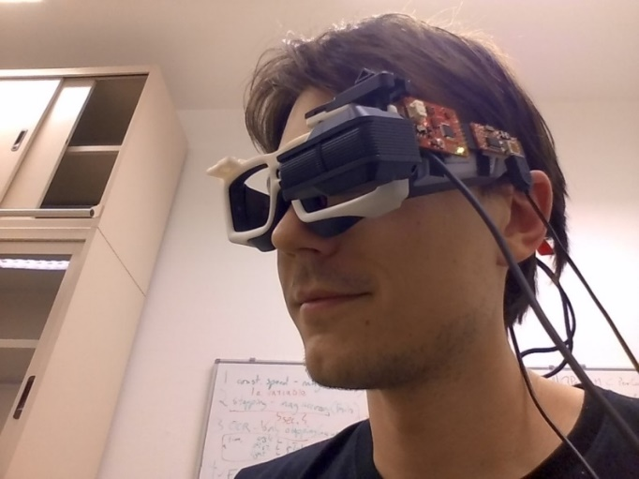
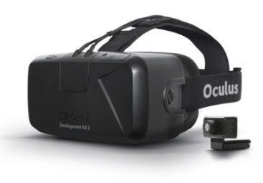
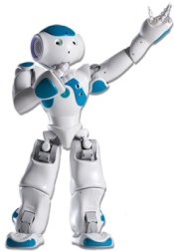
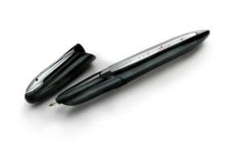
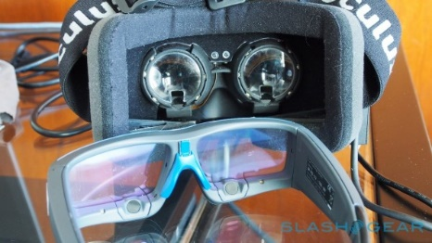
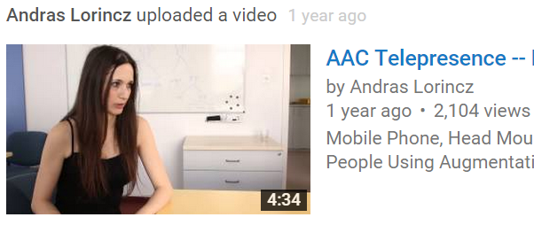
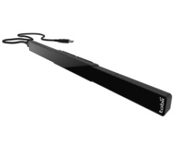
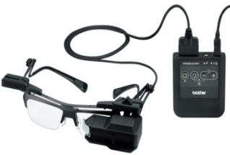
Interaction of the 2nd kind: IoT Making Individuals Accessible to Artificial Intelligence
Smart tools for smart environments
Epson Moverio BT-200
SMI and Tobii Eye-trackers
with cameras
Pupil Labs
Eye-tracker
RealSense depth camera
Oculus DK 2
NAO Humanoid
Anoto
Tobii EyeX
Oculus with SMI
Brother Airscouter

Slide 5
Interaction of the 3rd kind: Robots Making Individuals Accessible to Artificial Intelligence

Slide 6
Learning starts with anomaly detection
scenario: system is randomly interrupted during task solving, without specifying what the "interrupt" means
method: efficient sparse coding in regularised PCA
test setup finished, data recorded, methods implemented.
methods must be optimised to solve the problem.

Slide 7
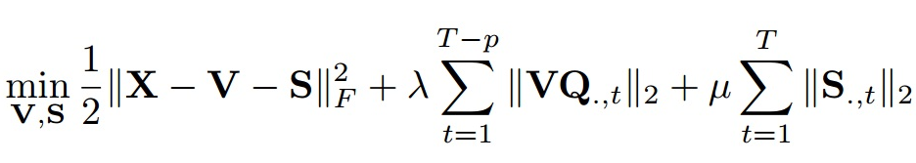
Temporal segmentation
Temporal segment: constant (coherent, invariant) behavior over time.
Boundaries of temporal segment: start and end point, behavior shift.
The boundaries of the segments are much less frequent than the inner points of the segments:
boundaries are ”sparse”.
Anomalies: model based outliers, much less frequent than the well fitted points:
anomalies are ”sparse”.
Math: solve ℓ₁ regularized convex optimization problem.
Loss: reconstruction error + sparse edges + sparse anomalies
General method: can be applied to any temporal data. Unsupervised.

Slide 8
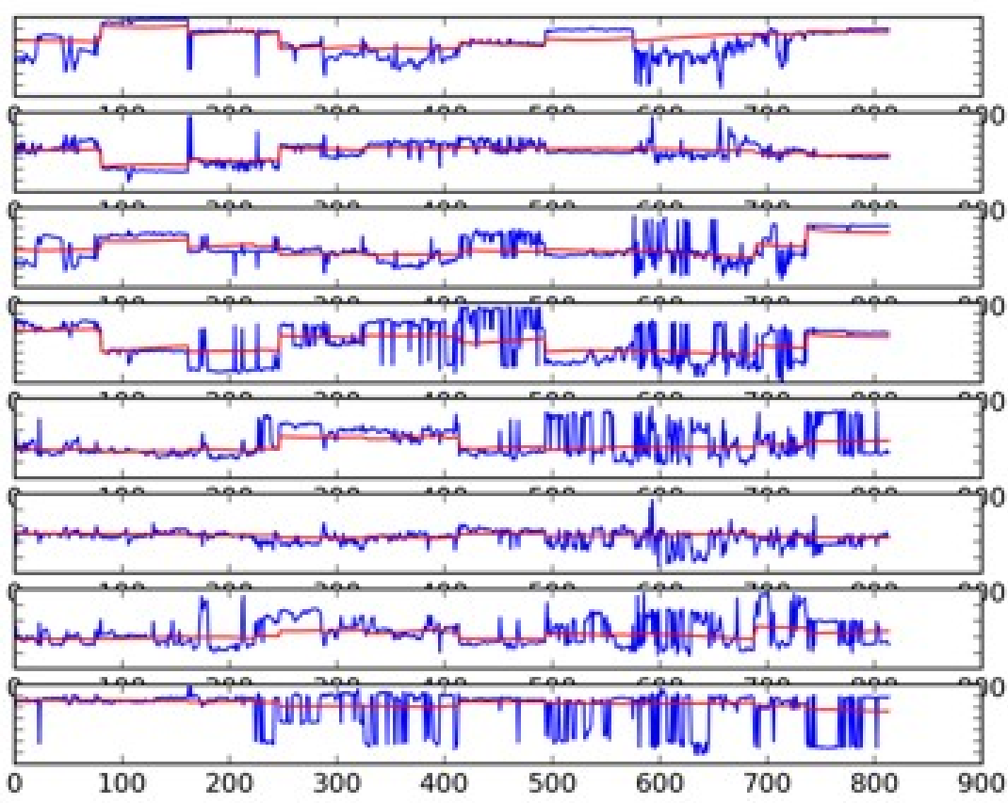
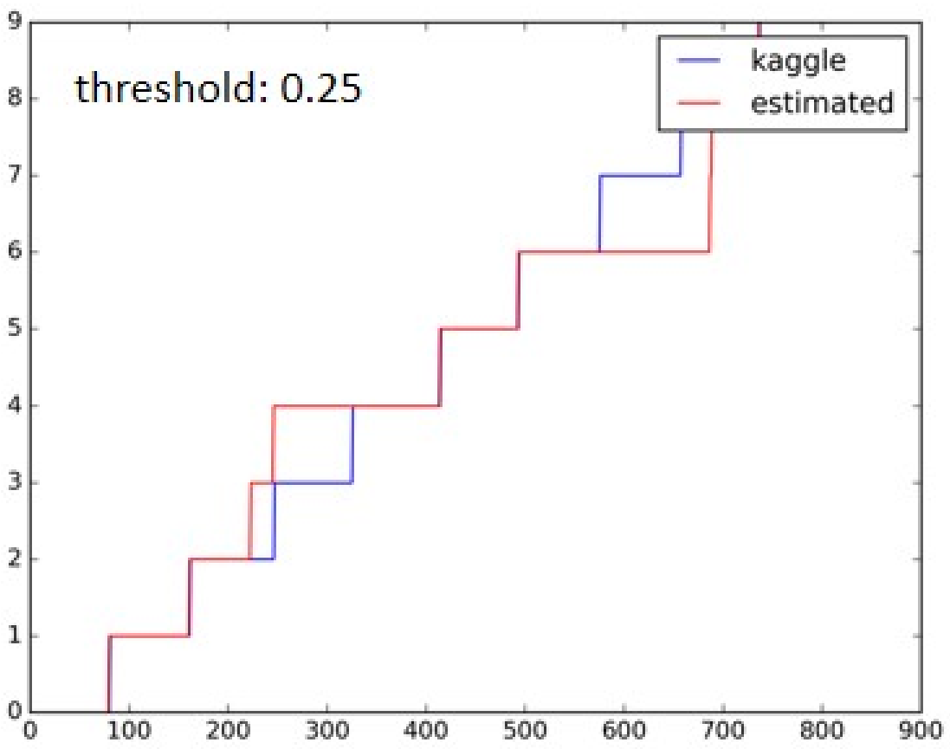
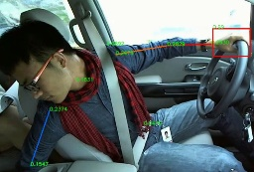
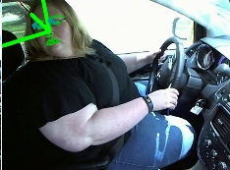
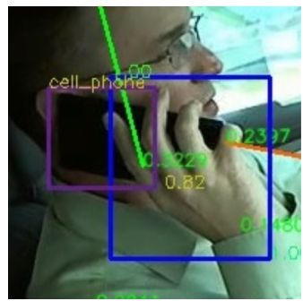
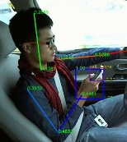
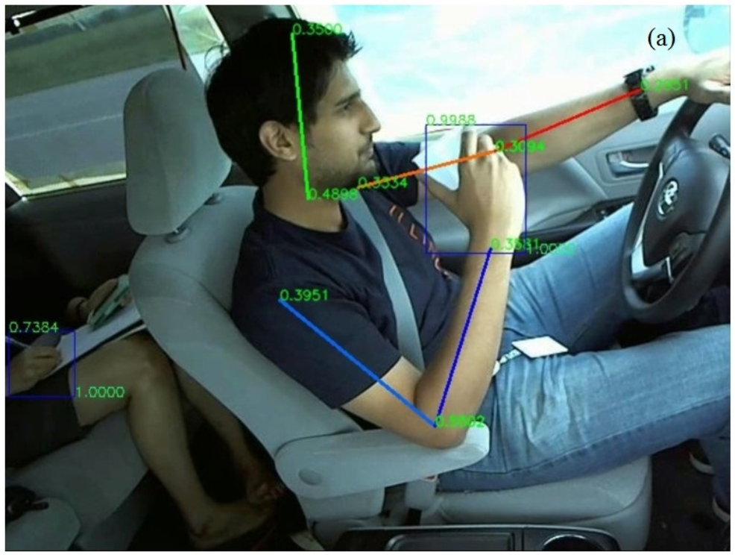
Example: Driving scenario
Body pose: coordinates for 4 wrists and for 4 elbows
Result of segmentation using only temporal information
Searching
Talking
Drinking
Phoning
Texting

Slide 9
Many robots + humans

Slide 10
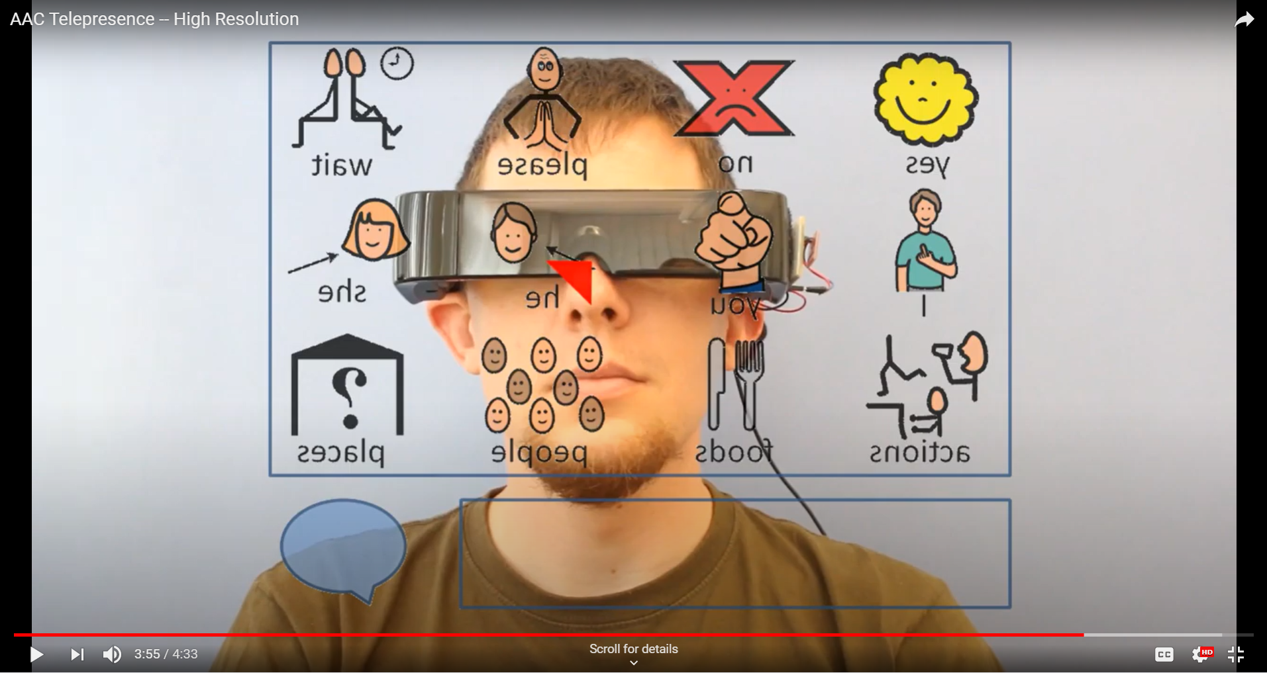
Interaction of the 4th kind: Inside-Outside Making Everybody Accessible to Artificial Intelligence

Slide 11
Interaction of the 5th kind: Global Monitoring Making Everybody Accessible to Artificial Intelligence

Slide 12
This
is the
End!
lorincz@inf.elte.hu

